Slide 1
Surrogate Variable Analysis On Unbalanced Heterogeneity
Meilei Jiang
Department of Statistics and Operations Research

Slide 2
Review of Surrogate Variable Analysis
The overall goal of SVA is to provide a more accurate and reproducible parsing of signal and noise in the analysis of an expression study when EH is present.

Slide 3
Review of Surrogate Variable Analysis
Step 1: Detect the surrogate variable
Remove the signal due to the primary variable of interest to obtain a residual expression matrix.
Apply a decomposition to the residual expression matrix to identify signatures of EH (Expression Heterogeneity).
Use a statistical test to determine the singular vectors that represent significantly more variation than would be expected by chance.
To ensure that the surrogate variables indeed estimate EH and not the signal.

Slide 4
Review of Surrogate Variable Analysis
Step 2: Identify the subset of genes driving each orthogonal signature of EH.
Apply a significance analysis of associations between genes and the EH signatures on the residual matrix.
To ensure an accurate estimate of each surrogate variable by identifying the specific subset of genes driving each EH signature

Slide 5
Review of Surrogate Variable Analysis
Step 3: For each subset of genes, build a surrogate variable based on the full EH signature of that subset in the original expression data.
To allow for correlation between the primary variable and the surrogate variable by building the surrogate variables on the original expression data

Slide 6
Review of Surrogate Variable Analysis
Step 4: Include all significant surrogate variables as covariates in subsequent regression analysis.
To take into account the fact that a surrogate variable may have a different effect on each gene.

Slide 7
Design of Simulation
High dimension low sample size setting:
80 samples in columns, 100 genes in rows
80 samples are associated with two classes: Class 1 and Class 2.
Primary Variable Vector: y = (1_{n11}, 1_{n12}, 0_{n21}, 0_{n22})
80 samples are collected from two batches: Batch 1 and Batch 2
π₁ of samples in Class 1 are collected from Batch 1
π₂ of samples in Class 2 are collected from Batch 1
Batch Vector: y = (1_{n11}, 0_{n12}, 1_{n21}, 0_{n22})

Slide 8
Design of Simulation
Balance Design: π₁ = π₂ = 0.5
Unbalance Design
Case 1: π₁ = π₂, π₁ + π₂!= 1
Batch vector and primary variable vector are uncorrelated.
Sizes of two batches are different.
Case 2: π₁ != π₂, π₁ + π₂ = 1
Batch vector and primary variable vector are correlated.
Sizes of two batches are the same.
Case 3: π₁ != π₂, π₁ + π₂ != 1
Batch vector and primary variable vector are uncorrelated.
Sizes of two batches are different.

Slide 9
Design of Simulation
Fixed Effects Two Way ANOVA settings for primary variable effect and batch effect.
Gene 1 – t1: Primary variable effect + random noise
Gene t1 + 1 – t2: Primary variable effect + batch effect + random noise
Gene t2 + 1 – t3: batch effect + random noise
Gene t3 – t4: random noise
In this simulation, (t1, t2,t3, t4) = (20, 40, 60, 100)
40% genes are effected by primary variable.
40% genes are effected by batch.
20% genes are effected by both.

Slide 10
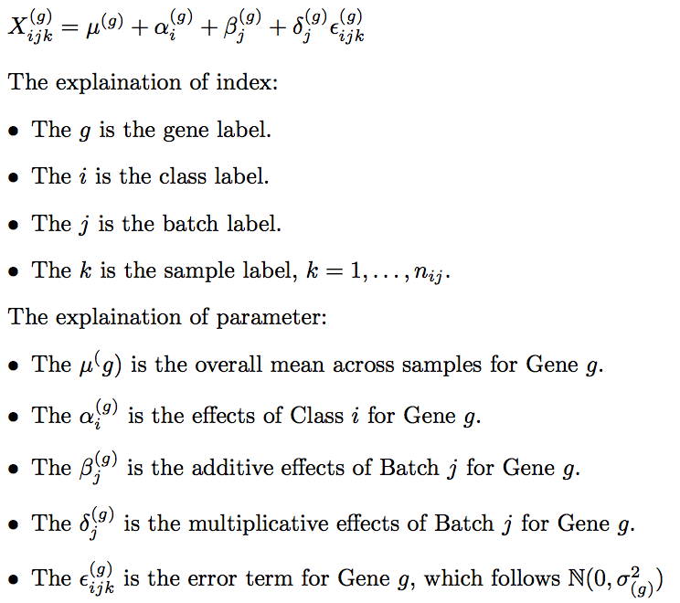
Location and Scale Batch Effect Model

Slide 11
Design of Simulation
Primary Variable Effect
Class 1: α₁ = 2
Class 2: α₂ = -2
Batch Effect:
Additive Effect
Batch 1: β₁ = 2
Batch 2: β₂ = 2
Multiplicative Effect
Batch 1: δ₁ = 1
Batch 2: δ₂ = 2
Random Noise
N(0 , 1)

Slide 12
Unbalance Design Case 1
Data Set 1:
π₁ = π₂ = 0.4
Size of Batch 1: p₁ = 0.4
Size of Batch 2: p₂ = 0.6
Angle(b, y) = 90°
Batch effect is additive.
Angle(b, sv) = 7.07°

Slide 13
Unbalance Design Case 1: Data Set 1

Slide 14
Unbalance Design Case 1: Data Set 1

Slide 15
Unbalance Design Case 1
Data Set 2:
π₁ = π₂ = 0.1
Size of Batch 1: p₁ = 0.1
Size of Batch 2: p₂ = 0.9
Angle(b, y) = 90°
Batch effect is additive.
Angle(b, sv) = 10.53°

Slide 16
Unbalance Design Case 2: Data Set 2

Slide 17
Unbalance Design Case 1: Data Set 2

Slide 18
Unbalance Design Case 1: Additive Batch Effect
Difference in the batch size will shift the estimation of primary variable effect.
The SVA algorithm can not adjust the shift.
The SVA algorithm can find the batch vector.

Slide 19
Unbalance Design Case 1
Data Set 3:
π₁ = π₂ = 0.4
Size of Batch 1: p₁ = 0.4
Size of Batch 2: p₂ = 0.6
Angle(b, y) = 90°
Batch effect is multiplicative.
Angle(b, sv) = 68.93°

Slide 20
Unbalance Design Case 1: Data Set 3

Slide 21
Unbalance Design Case 1: Data Set 3

Slide 22
Unbalance Design Case 1
Data Set 4:
π₁ = π₂ = 0.1
Size of Batch 1: p₁ = 0.1
Size of Batch 2: p₂ = 0.9
Angle(b, y) = 90°
Batch effect is multiplicative.
Angle(b, sv) = 67.47°

Slide 23
Unbalance Design Case 1: Data Set 4

Slide 24
Unbalance Design Case 1: Data Set 4

Slide 25
Unbalance Design Case 2
Data Set 1:
π₁ = 0.6, π₂ = 0.4
Size of Batch 1: p₁ = 0.5
Size of Batch 2: p₂ = 0.5
Angle(b, y) = 78.46°
Batch effect is additive.
Angle(b, sv) = 5.84°

Slide 26
Unbalance Design Case 2: Data Set 1

Slide 27
Unbalance Design Case 2: Data Set 1

Slide 28
Unbalance Design Case 2
Data Set 2:
π₁ = 0.9, π₂ = 0.1
Size of Batch 1: p₁ = 0.5
Size of Batch 2: p₂ = 0.5
Angle(b, y) = 36.87°
Batch effect is additive.
Angle(b, sv) = 82.69°

Slide 29
Unbalance Design Case 2: Data Set 2

Slide 30
Unbalance Design Case 2: Data Set 2

Slide 31
Unbalance Design Case 2: Additive Batch Effect
Positive correlation between batch vector and primary variable vector will amplify the estimation of primary variable effect.
The SVA algorithm can adjust the amplification.
The SVA algorithm can find the batch vector.

Slide 32
Unbalance Design Case 2
Data Set 3:
π₁ = 0.6, π₂ = 0.4
Size of Batch 1: p₁ = 0.5
Size of Batch 2: p₂ = 0.5
Angle(b, y) = 78.46°
Batch effect is multiplicative.
Angle(b, sv) = 62.52°

Slide 33
Unbalance Design Case 2: Data Set 3

Slide 34
Unbalance Design Case 2: Data Set 3

Slide 35
Unbalance Design Case 2
Data Set 4:
π₁ = 0.9, π₂ = 0.1
Size of Batch 1: p₁ = 0.5
Size of Batch 2: p₂ = 0.5
Angle(b, y) = 36.87°
Batch effect is multiplicative.
Angle(b, sv) = 87.30°, 88.83°, 88.65°

Slide 36
Unbalance Design Case 2: Data Set 4

Slide 37
Unbalance Design Case 2: Data Set 4

Slide 38
Unbalance Design Case 3
Data Set 1:
π₁ = 0.55, π₂ = 0.35
Size of Batch 1: p₁ = 0.45
Size of Batch 2: p₂ = 0.55
Angle(b, y) = 78.40°
Batch effect is additive.
Angle(b, sv) = 7.09°

Slide 39
Unbalance Design Case 3: Data Set 1

Slide 40
Unbalance Design Case 3: Data Set 1

Slide 41
Unbalance Design Case 3
Data Set 2:
π₁ = 0.4, π₂ = 0.1
Size of Batch 1: p₁ = 0.25
Size of Batch 2: p₂ = 0.75
Angle(b, y) = 69.73°
Batch effect is additive.
Angle(b, sv) = 8.31°

Slide 42
Unbalance Design Case 3: Data Set 2

Slide 43
Unbalance Design Case 3: Data Set 2

Slide 44
Unbalance Design Case 3: Additive Batch Effect
In this case, the estimation of primary variable are both amplified and then shifted.
The SVA algorithm can not adjust the shift.
The SVA algorithm can adjust the amplification.

Slide 45
Unbalance Design Case 3
Data Set 3:
π₁ = 0.55, π₂ = 0.35
Size of Batch 1: p₁ = 0.45
Size of Batch 2: p₂ = 0.55
Angle(b, y) = 78.40°
Batch effect is multiplicative.
Angle(b, sv) = 60.81°

Slide 46
Unbalance Design Case 3: Data Set 3

Slide 47
Unbalance Design Case 3: Data Set 3

Slide 48
Unbalance Design Case 3
Data Set 4:
π₁ = 0.4, π₂ = 0.1
Size of Batch 1: p₁ = 0.25
Size of Batch 2: p₂ = 0.75
Angle(b, y) = 69.73°
Batch effect is multiplicative.
Angle(b, sv) = 83.83°, 85.13°, 84.11°, 89.36°

Slide 49
Unbalance Design Case 3: Data Set 4

Slide 50
Unbalance Design Case 3: Data Set 4

